Slide 1
CAMPUS EATS
Deeksha Umesh
Rama Suchitha Challa
Pavan Vooturi
Priyatham Kumar Gajula

Slide 2
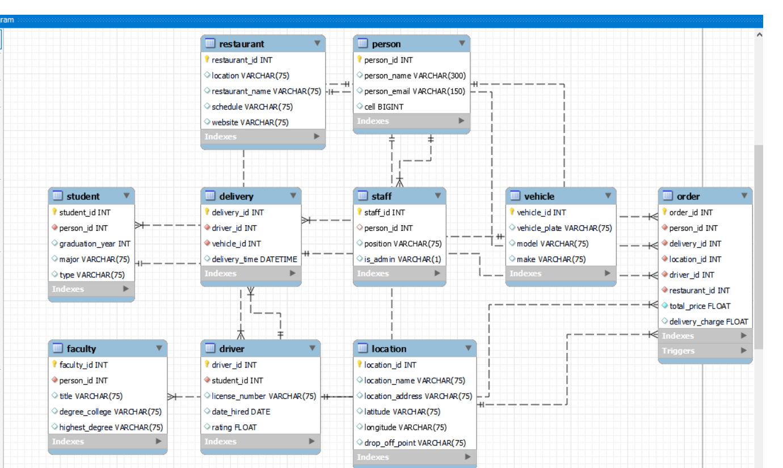
INITIAL MODEL

Slide 3
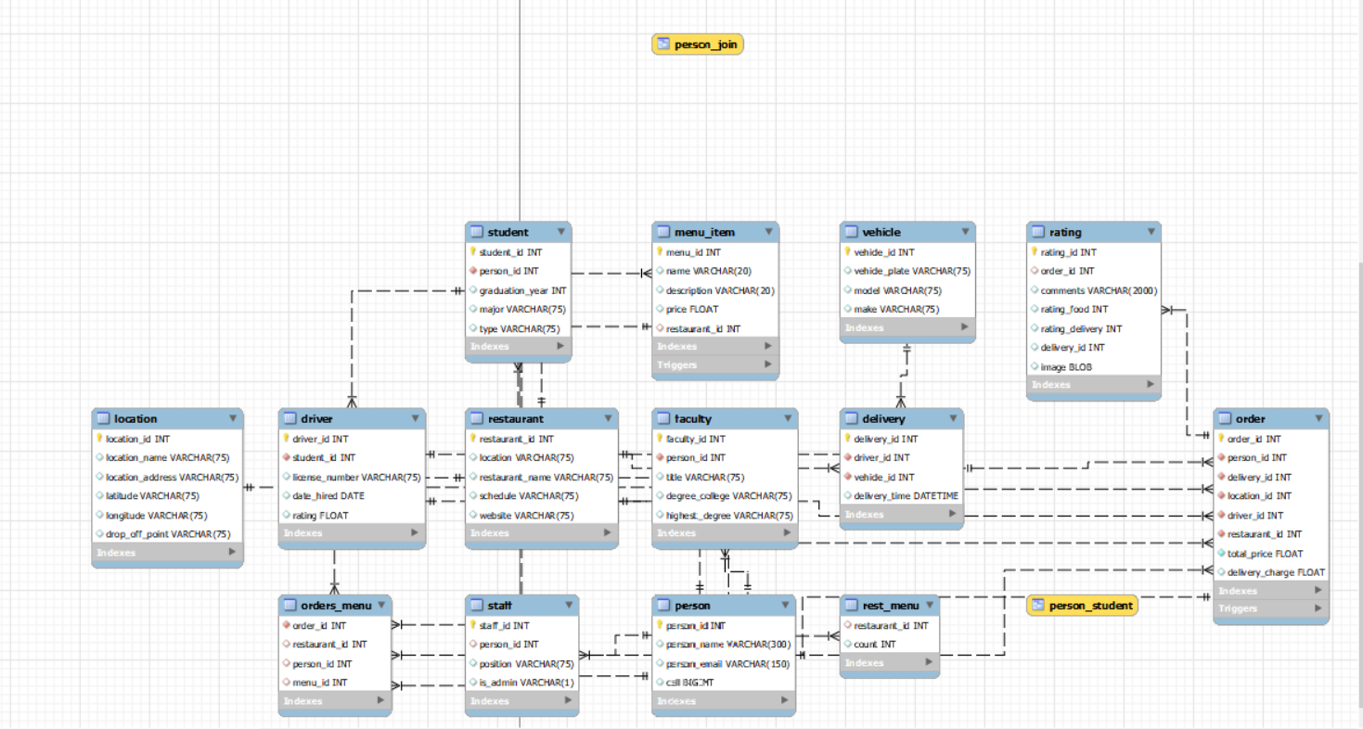
NEW MODEL (Modified)

Slide 4
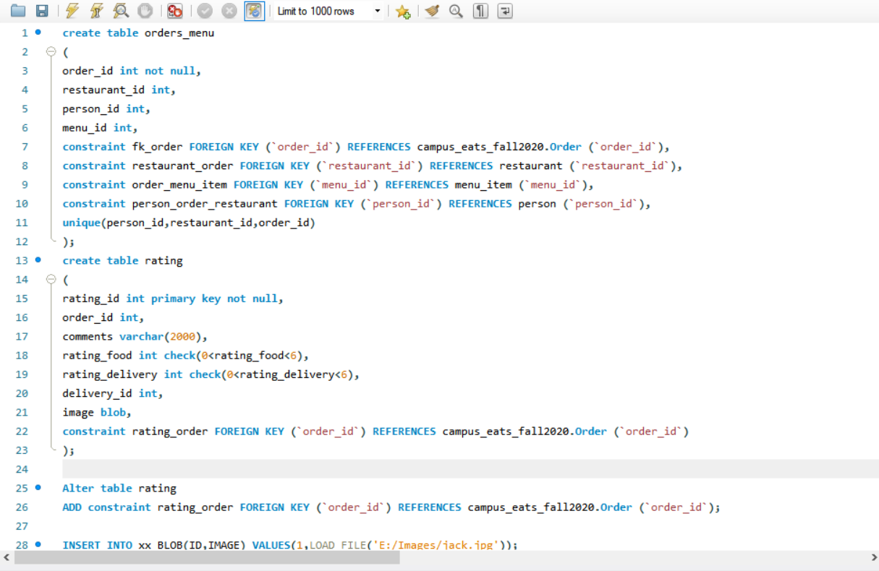
Creating Entities

Slide 5
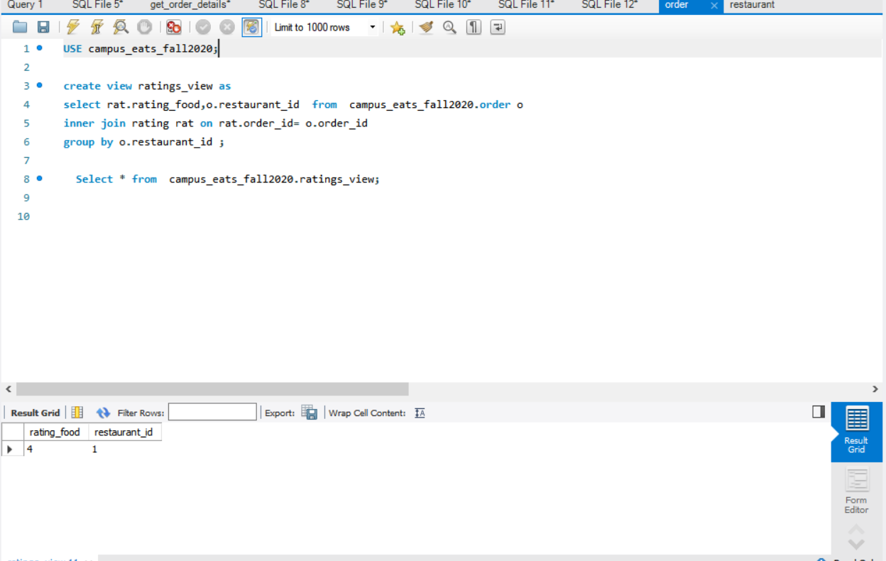
VIEW 1: restaurant_rating_view

Slide 6
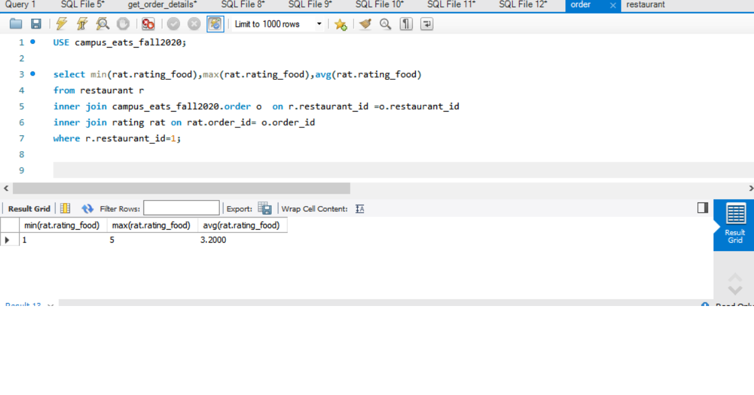
2. restaurant_ratings

Slide 7
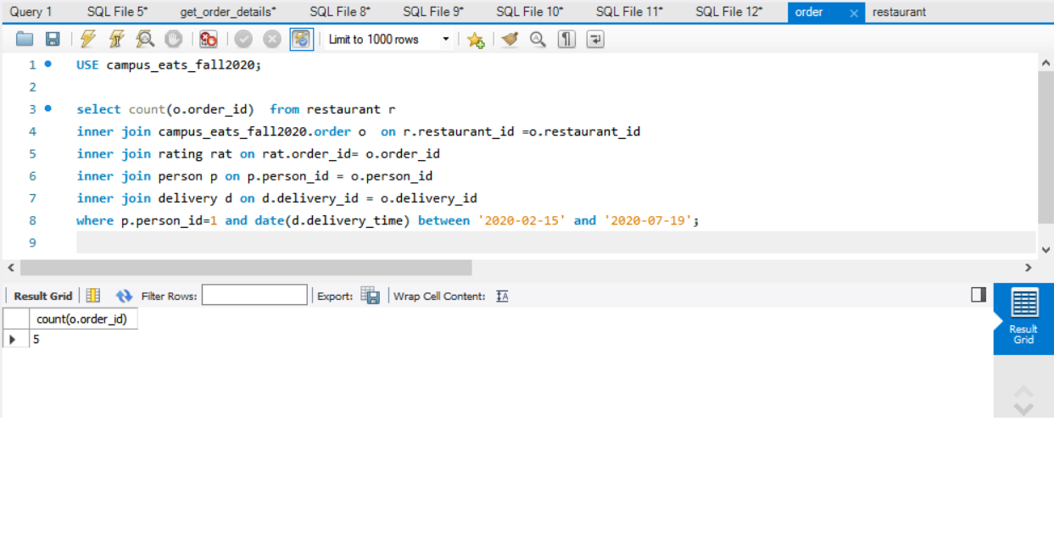
3.

Slide 8
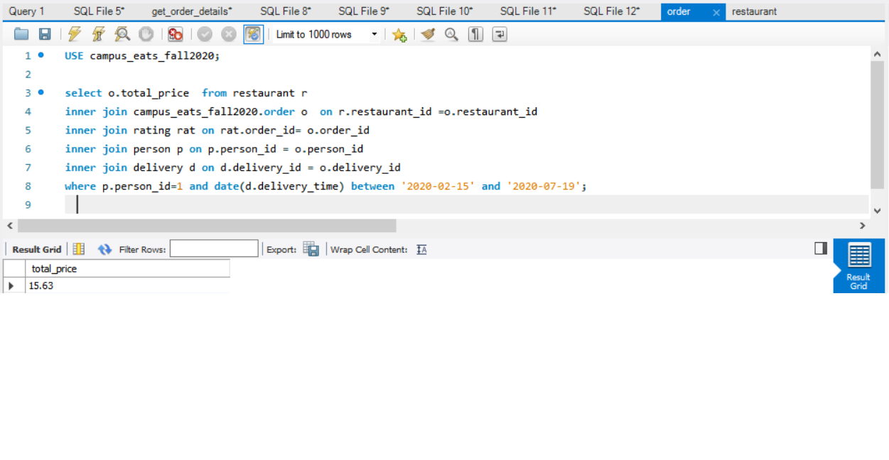

Slide 9
